Slide 1
CREDIT CARD FRAUD DETECTION
Group 10
Nikhil Patil (Team Lead) ( PRN No. 220310125010 )
Pritaj Borole ( PRN No. 220310125023 )
Dipesh Chaudhari ( PRN No. 220310125012 )
Project Co-Ordinator
Dr. Zeeshan Ahmad Khan

Slide 2
CONTENT
Problem Statement
Introduction
Objective
Challenges
Software & Hardware Requirement
Data analysis technique
MODULES AND DESCRIPTION
Data flow diagram
Project working
Final result
Conclusion
FUTURE SCOPE
REFRENCES

Slide 3
PROBLEM STATEMENT
The credit card fraud detection problem includes modeling past credit card transactions with the knowledge of the ones that turned out to be a fraud.
This model is then used to identify whether a new transaction is fraudulent or not.

Slide 4
INTRODUCTION
Financial fraud is a growing concern with far reaching consequences in the government, corporate organizations, finance industry.
credit card fraud has also accelerated as online and offline transaction.
There are many fraud detection solutions and software which prevent frauds in businesses such as credit card, retail, e-commerce, insurance, and industries.
Several techniques are designed and implemented to solve credit card fraud detection such as comparative analysis of Logistic Regression, SVC, KNN and Random Forest is carried out.

Slide 5
OBJECTIVE
To implement machine learning algorithms to detect credit card fraud detection with respect to time and amount of transaction.
Finding hidden and implicit correlations in data.
The Reduced number of Verification measures.
Real Time Processing.

Slide 6
CHALLENGES
It's not always easy to agree on ground truth for what "fraud" means.
Most merchants aren't experts at evaluating the business impact of fraud.

Slide 7
SOFTWARE & HARDWARE REQUIREMENT
Software hardware
Languages :- Python-3 CPU : - Intel Pentium IV 600MHz
Operating System :- Windows, Linux, etc. Hard Disk Space : - 20 GB or More
Back End Software : - Anaconda, Memory : - 4GB RAM
Jupyter Notebook

Slide 8
DATA ANALYSIS TECHNIQUE
There are three technique to analyzed data
under sampling :-
Under sampling is a technique to balance uneven datasets by keeping all of the data in the minority class and decreasing the size of the majority class.
It is one of several techniques data scientists can use to extract more accurate information from originally imbalanced datasets.
Over sampling :-
Oversampling is appropriate when data scientists do not have enough information. One class is abundant, or the majority, and the other is rare, or the minority.
In oversampling, the increases the number of rare events.

Slide 9
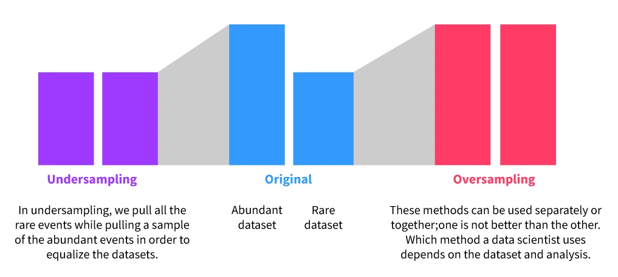
SOMTE :- (synthetic minority oversampling technique)
it is a statistical technique for increasing the number of cases in your dataset in a balanced way.
The component works by generating new instances from existing minority cases that you supply as input.

Slide 10
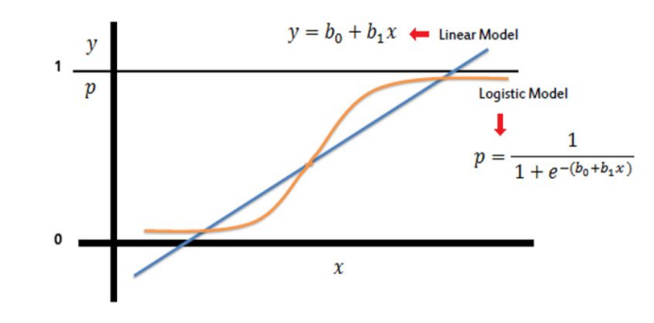
MODULES AND DESCRIPTION
Algorithms :-
Ability of system to automatically learn and improve from experience without being explicitly programmed is called machine learning. And it focuses on the development of computer programs that can access data and use it to learn by themselves. In this project there are using four types of machine learning algorithms.
Logistic Regression : -
Logistic Regression is a supervised classification
method that returns the probability of binary
dependent variable that is predicted from the
independent variable of dataset.
i.e. logistic regression predicts the probability
of an outcome which has two values, either
zero or one, no or yes and false or true.
LOGISTIC CURVE

Slide 11
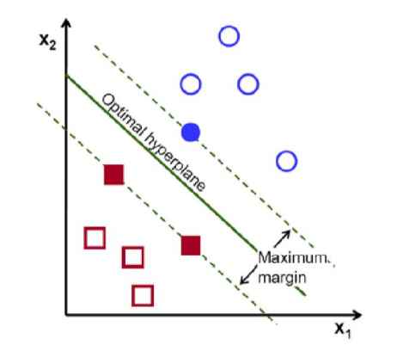
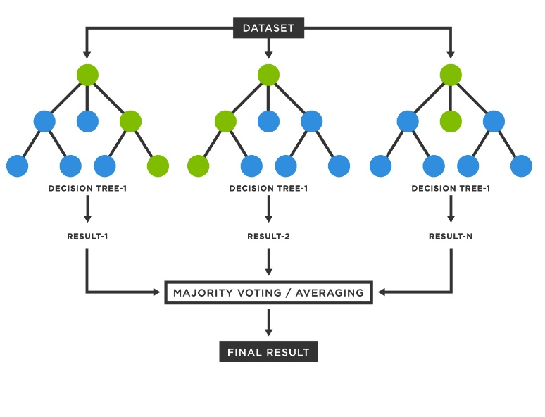
B. SVM Model (Support Vector Machine) :-
SVM modelling involves two steps, firstly to train a data
set and to obtain a model & then, to use this model to predict
information of a testing data set.
A Support Vector Machine (SVM) is a discriminative classifier
formally defined by a separating hyperplane where SVM
model represents the training data points as points in space
and then mapping is done so that the points which are of
different classes are divided by a gap that is as wide as possible.
C. Random Forest :-
It builds decision trees on different samples and takes
their majority vote for classification and average in case
of regression. One of the most important features of the
Random Forest Algorithm is that it can handle the data
set containing continuous variables as in the case of
regression and categorical variables as in the
case of classification.. It performs better results for classification problems..

Slide 12
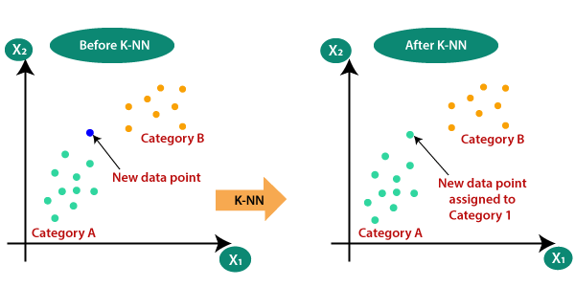
D. K-Nearest Neighbour Classifier :-
KNN also called K- nearest neighbour is a supervised machine learning algorithm that can be used for classification and regression problems.
K nearest neighbour is one of the simplest algorithms to learn. K nearest neighbour is non-parametric i,e. It does not make any assumptions for underlying data assumptions.
K-nearest neighbuor classifier

Slide 13
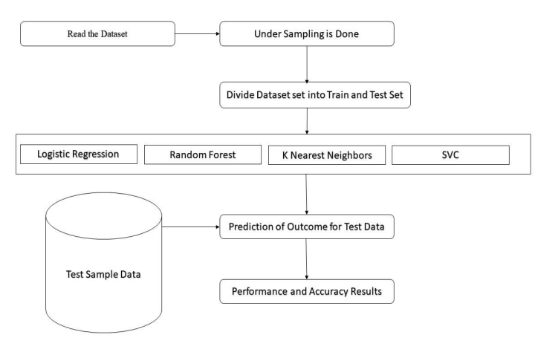
DATA FLOW DIAGRAM

Slide 14
PROJECT WORKING
It is important that credit card companies are able to recognize fraudulent credit card transactions so that customers are not charged for items that they did not purchase.
Data set :-
The datasets contain transactions made by credit cards in September 2013 by European cardholders.
This dataset presents transactions that occurred in two days, where we have 492 frauds out of 284,807 transactions. The dataset is highly unbalanced.

Slide 15
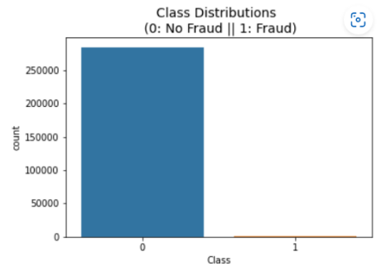


Slide 16
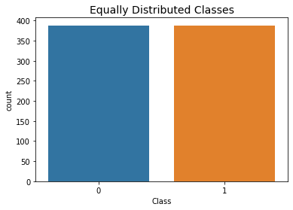
UNDERSAMPLING
Number of Fraud cases in Training set: 388
Number of Fraud cases in Training set after balancing: 388

Slide 17
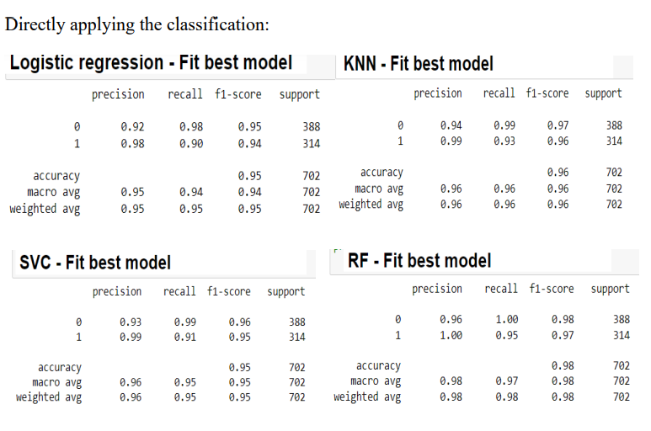
RESULTS

Slide 18
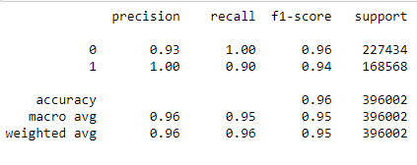
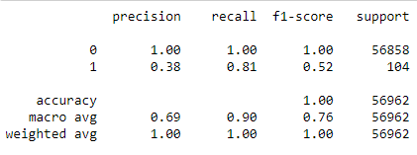
OVERSAMPLING (SMOTE) SYNTHETIC MINORITY OVERSAMPLING TECHNIQUE
Random Forest Trainging Classification Report
Random Forest Testing Classification Report

Slide 19

RESULT OF CREDIT CARD FRAUD DETECTION
Implementing SMOTE on our imbalanced dataset helped us with the imbalance of our labels (more no fraud than fraud transactions).
Also, in our undersample data our model is unable to detect for a large number of cases non fraud transactions correctly and instead, misclassifies those non fraud transactions as fraud cases.
As we can see from the above test scores, the SMOTE method has performed better than random undersampling in this scenario.

Slide 20
CONCLUSION
Machine learning technique like Logistic regression, Random forest, K-Nearest Neighbours, SVC classifiers were used to detect the fraud in credit card system.
Sensitivity, Specificity, accuracy and error rate are used to evaluate the performance for the proposed system.
From the experiments, the result that has been concluded is that Logistic regression has an accuracy of 95% while SVC shows accuracy of 95%, KNN with 96% and Random forest shows accuracy of 98% but the best results are obtained by Random Forest with a precise accuracy of 98 %.

Slide 21
FUTURE SCOPE
With increasing number of bank fraudulency and cyber-crime cases, need of a secure testing system is on rise. And this is a direct solution to this problem.
It can be extended to a duplex verification of not only a customer(debit-ant) but also of the seller(credit-ant). It can be taken and used on a regular basis just like OTP.
It can be used to even assess past transaction in database to find whether certain transactions were fraudulent or not and also would be able to produce evidence in such cases.

Slide 22
REFRENCES
1. Y. Sahin, S. Bulkan, and E. Duman, ‘‘A cost-sensitive decision tree approach for fraud detection,’’ Expert Syst. Appl., vol. 40, no. 15, pp. 5916–5923, 2013.
2. Sahil Dhankhad, Emad A. Mohammed and Behrouz Far, “Supervised Machine Learning Algorithms for Credit Card Fraudulent Transaction Detection: A Comparative Study ”
3. Navanshu Khare and Saad Yunus Sait, “Credit Card Fraud Detection Using Machine Learning Models and Collating Machine Learning Models ”
4. Lakshmi S V S S1,Selvani Deepthi Kavila2 “Machine Learning For Credit Card Fraud Detection System”

Slide 23
THANK YOU

